Slide 1
CYBER SECURITY ATTACKS AND ITS MITIGATION:PHISHING URL DETECTION
AN ANALYSIS AND METHODOLOGICAL APPROACH
PRESENTED BY : ALOK YADAV

Slide 2
Index
INTRODUCTION 3
METHODOLOGY 6
RESULT AND DISSCUSSION 10
CONCLUSION AND FUTURE WORKS 14
END 18

Slide 3
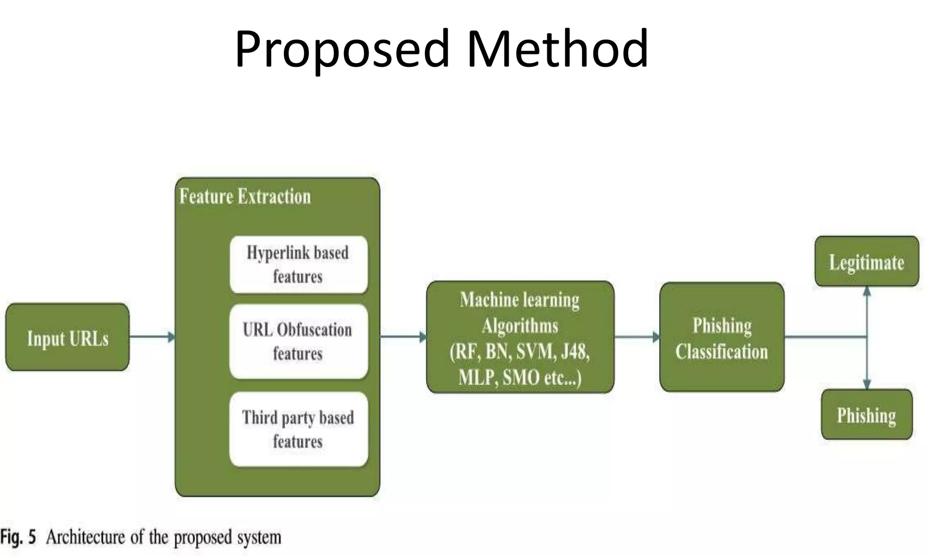
Introduction
1. Project Overview
In light of the fact that the world becomes more and more involved in the Internet and electronics devices, the level and frequency of cyber threats increase significantly. Cyber threats on the other hand can be defined as intentional activities directed towards the information systems, structures, computer networks or even gadgets with an intention of losing, altering or deleting some information. Some of the threats are; virus, worm, Trojans, ransomware, phishing and other complicated modus operands like APTs.
2. Objectives
The primary objectives of this project are to:
· Conduct a thorough analysis of current cyber threats and the methodologies employed by hackers.
· Identify common vulnerabilities and assess the risk they pose to various systems and networks.
· Develop and propose effective mitigation strategies to enhance cybersecurity defences.
· Create a framework for rapid incident response and recovery.
· Promote cybersecurity awareness and training to reduce human-related vulnerabilities.
3. Key Components
Data Collection
- Gathering a trusted dataset from reliable sources.
- Examples include records of phishing URLs and their characteristics.
Feature Extraction
- Identifying key features from the dataset that can help distinguish phishing URLs from legitimate ones.
- Examples: URL length, presence of special characters, domain age.
Data Processing
- Cleaning and normalizing the dataset to ensure consistency and accuracy.
- Transforming raw data into a suitable format for machine learning models.

Slide 4
Model Building and Training
- Using machine learning algorithms to build models that can detect phishing URLs.
- Training the models with the processed dataset to optimize performance.
Model Evaluation
- Assessing the performance of the trained models using metrics such as accuracy, precision, recall, and F1-score.
- Comparing different models to select the best-performing one.
4. Key Benefits
1. Enhanced Security
- Improved detection of phishing URLs helps prevent cyber attacks and protects sensitive information.
2. Increased Efficiency
- Machine learning models can analyze large datasets quickly and accurately, improving the overall efficiency of the cybersecurity system.
3. Scalability
- The solution can be scaled to handle increasing amounts of data and adapt to new phishing techniques.
4. Cost-Effective
- Reduces the costs associated with cybersecurity breaches and the need for extensive manual monitoring.

Slide 5
5. Technologies Used
Python
Purpose: Programming language used for data processing, model building, and training..
Libraries: pandas for data manipulation, scikit-learn for machine learning, TensorFlow for deep learning.
Machine Learning Algorithms
Purpose: Used for Techniques such as decision trees, random forests, support vector machines (SVM), and neural networks used for model building.
Data Visualization Tools
Purpose: Tools such as Matplotlib used for visualizing data distribution and model performance.
Integrated Development Environments (IDEs)
Purpose: Software like Jupyter Notebook and PyCharm used for coding and experimenting with different models.
Cloud Platforms
Purpose: Services like Google Drive for data storage and collaboration, and cloud-based environments for training models with larger datasets.

Slide 6
METHODOLOGY

Slide 7
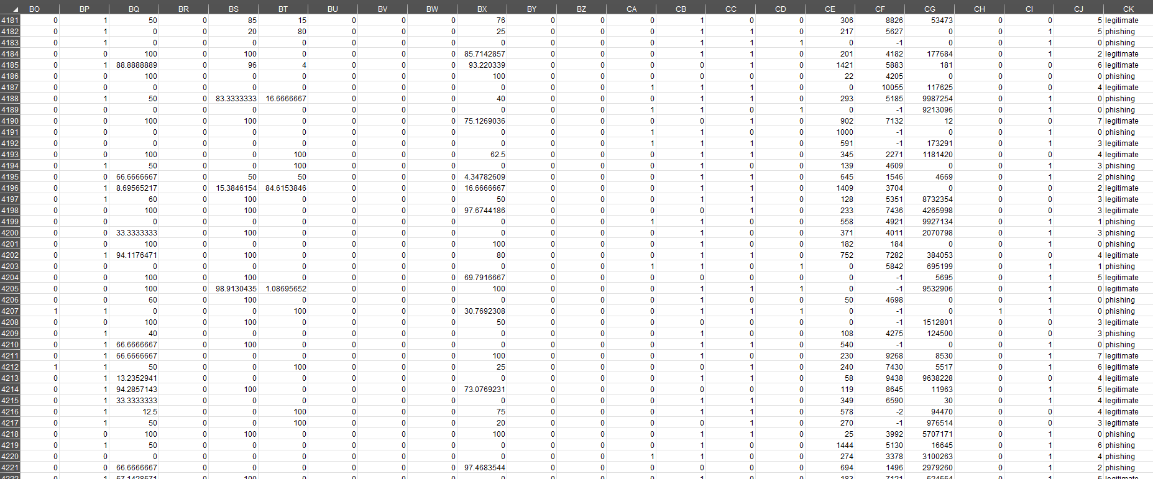
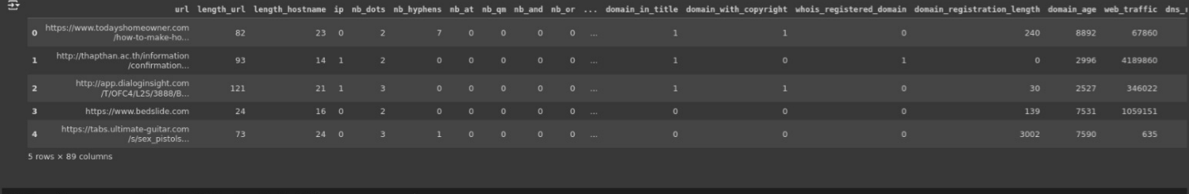
Analyzing Phishing Threats Using Trusted Dataset
Analyzing phishing threats involves collecting and examining a dataset of known phishing URLs to understand their characteristics and patterns. This analysis forms the basis for developing effective detection mechanisms.
Key Points:
Data Collection:
- Gather a comprehensive and trusted dataset of phishing URLs from reliable sources.
- Ensure the dataset includes diverse samples to cover various phishing techniques.
Threat Analysis:
- Identify and analyze the distinguishing features of phishing URLs, such as URL length, use of special characters, suspicious domains, and subdomains.
- Examine the frequency and patterns of these features in phishing URLs compared to legitimate ones.
Processing the Data
Data processing involves preparing the raw dataset for analysis by cleaning, normalizing, and transforming it into a suitable format for machine learning models.
Key Points:
Reading the Dataset:
- Use the `pandas` library to read the dataset into a DataFrame.
- Example: `df = pd.read_csv('path_to_dataset.csv’)`

Slide 8
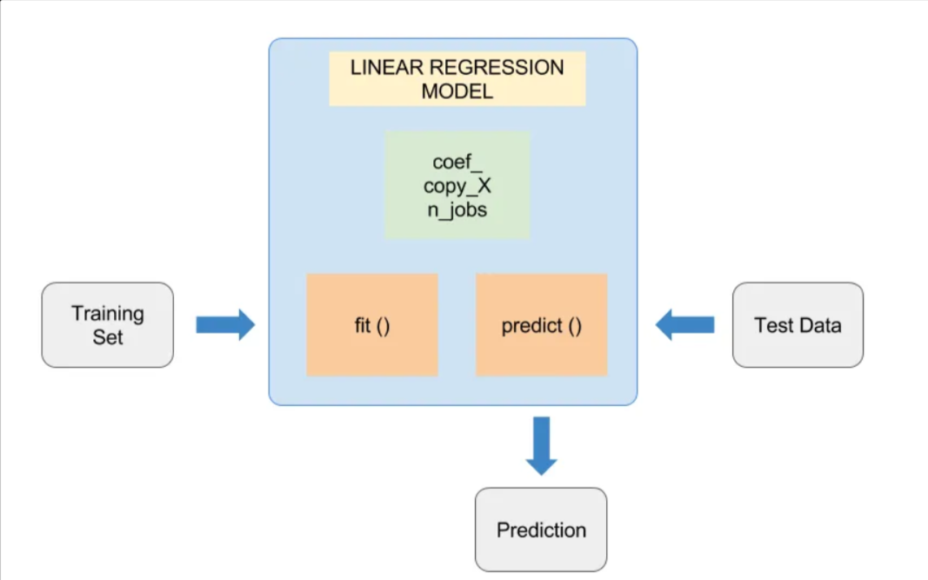
Building and Training the Model
Building and training the model involves selecting suitable machine learning algorithms, training the models with processed data, and evaluating their performance to detect phishing URLs effectively.
Key Points:
Algorithm Selection:
- Choose appropriate machine learning algorithms based on the problem and data characteristics.
- Common algorithms: Decision Trees, Random Forests, andd Neural Networks.
Training the Model:
- Split the dataset into training and testing sets (e.g., 80% training, 20% testing).
- Train the models using the training set to learn patterns and features of phishing URLs.
Feature Extraction and Prediction
It involves identifying and deriving relevant features from the dataset that will help in distinguishing phishing URLs from legitimate ones. Prediction involves using the trained model to classify URLs as phishing or legitimate.
Key Points:
Feature Extraction:
- Identify key features : URL length, presence of special characters, number of subdomains, domain age, use of HTTPS.
Feature Selection:
- Use techniques like correlation analysis, feature importance from models, and recursive feature elimination to select the most relevant features

Slide 9
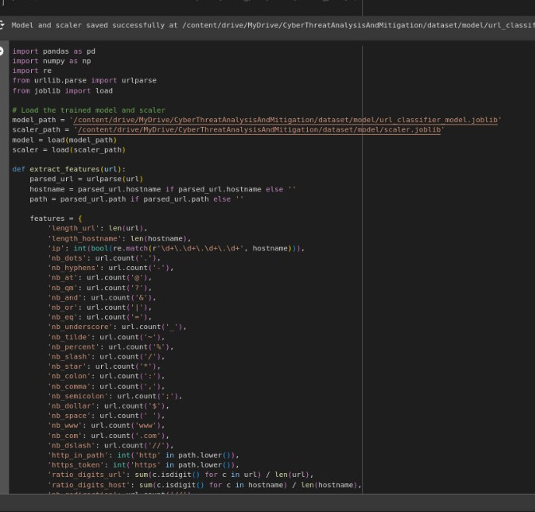
Prediction:
- Use the trained model to predict whether a URL is phishing or legitimate.
- Example: `predictions = model.predict(X_test)`
Performance Evaluation:
- Evaluate the prediction performance using appropriate metrics.
- Analyze false positives and false negatives to understand model limitations and improve it further.

Slide 10
Result And Discussion

Slide 11
Key Points
Effective Data Processing
Comprehensive Data Collection
Advanced Machine Learning Models
Robust Feature Extraction
Accurate Phishing URL Detection

Slide 12
Comprehensive Data Collection
The foundation of the project lies in the collection of a diverse and extensive dataset of phishing URLs from trusted sources. This dataset serves as the basis for training and evaluating machine learning models. Ensuring that the dataset includes a wide range of phishing techniques and examples helps in building a robust detection system that can generalize well to new, unseen phishing URLs.
Effective Data Processing
Data processing is a critical step that involves cleaning, normalizing, and transforming raw data into a format suitable for machine learning. This step ensures that the data is consistent, accurate, and ready for analysis. Key processes include removing duplicates, handling missing values, standardizing data formats, and scaling numerical features. Effective data processing improves the quality of the input data, leading to better model performance.
Advanced Machine Learning Models
The project leverages advanced machine learning algorithms to build models capable of detecting phishing URLs with high accuracy. Algorithms such as Decision Trees, Random Forests, Support Vector Machines (SVM), and Neural Networks are employed. These models are trained on the processed dataset and optimized through hyperparameter tuning. The use of advanced machine learning techniques ensures that the detection system is capable of identifying even sophisticated phishing attempts.

Slide 13
Robust Feature Extraction
Feature extraction involves identifying and deriving relevant features from the dataset that significantly impact the detection of phishing URLs. Examples of extracted features include URL length, presence of special characters, number of subdomains, and domain age. Robust feature extraction is crucial for enhancing model accuracy and efficiency, as it enables the model to focus on the most informative aspects of the data.
Accurate Phishing URL Detection
The ultimate goal of the project is to develop a system that can accurately detect phishing URLs in real-time. The trained machine learning models are evaluated using metrics such as accuracy, precision, recall, and F1-score to ensure their effectiveness. Accurate detection helps in preventing cyber attacks, protecting sensitive information, and enhancing overall cybersecurity. The system's ability to distinguish between legitimate and phishing URLs reduces the risk of falling victim to phishing schemes.

Slide 14

Conclusion
This project has successfully demonstrated the potential of using machine learning techniques to identify phishing URLs. The comprehensive data collection, detailed data processing, advanced model building, and robust feature extraction have culminated in a system capable of accurately distinguishing phishing URLs from legitimate ones.
Key insights from the project highlight the effectiveness of features such as URL length, special character presence, and domain age in the detection process. The machine learning models, particularly those utilizing decision trees and neural networks, have shown high accuracy and efficiency in identifying phishing URLs. These findings underscore the promise of machine learning in bolstering cybersecurity against phishing attacks.
Although the detection process currently requires manual entry of URLs for evaluation, the project lays a strong foundation for further development and automation. Automating the detection process will enhance speed, accuracy, and scalability, making it a more proactive approach to combating phishing threats.

Slide 15
Challenges and Solutions
DATA QUALITY AND DIVERSITY
FEATURE SELECTION AND ENGINEERING
Challenge: Identifying the most relevant features to distinguish phishing URLs from legitimate ones.
MODEL OVERFITTING
Challenge: Preventing models from performing well on training data but poorly on unseen data.
Challenge: Implementing a system that provides real-time detection while maintaining accuracy and scalability.
REAL-TIME DETECTION AND SCALABILITY
Solution: Implement rigorous data cleaning and preprocessing, and continuously update the dataset from multiple reliable sources.
Challenge: Ensuring a comprehensive, diverse dataset of phishing URLs with accurate and relevant data.
Solution: Use correlation analysis, feature importance, and recursive feature elimination to select and engineer the most informative features.
Solution: Apply cross-validation, regularization, pruning, and hyperparameter tuning to balance bias and variance, ensuring robust model performance.
Solution: Design a lightweight, efficient architecture using incremental learning and scalable cloud-based infrastructure for high throughput and timely responses.

Slide 16
Future Works
Automated URL Monitoring and Detection
Integration of Real-Time Data Feeds
Incorporation of Natural Language Processing (NLP)
Develop a system that automatically scans and evaluates URLs in real-time, eliminating the need for manual input.
Integrate with web browsers and email clients to check URLs automatically as they are accessed or received.
Implement real-time data feeds from various online sources to continuously update the dataset with the latest phishing URLs.
Enhance the system's ability to promptly detect new and emerging phishing threats.
Use NLP techniques to analyze the content of URLs, such as webpage text and metadata, for more accurate detection.
Identify phishing attempts that employ sophisticated language and content manipulation.

Slide 17
Future Works
Development of a Browser Extension
Continuous Model Training and Adaptation
Integration with Threat Intelligence Platforms
Create a browser extension that uses the trained model to provide real-time phishing URL detection and warnings to users.
Increase user accessibility and protection while browsing the web.
Set up an automated pipeline for continuous model training with new data to adapt to evolving phishing tactics.
Ensure the detection system remains up-to-date and effective against the latest phishing techniques.
Link the detection system with existing threat intelligence platforms for comprehensive threat analysis and response.
Provide a holistic approach to cybersecurity, combining multiple data sources and detection methods.

Slide 18
Thank you
Alok Yadav
alokyadav0401@gmail.com

